Slide 1


VISVISVESVARAYA TECHNOLOGICAL UNIVERSITY Jnana Sangama, Belgavi – 590018
AMC ENGINEERING COLLEGE
DEPARTMENT OF COMPUTER SCIENCE AND ENGINEERING
Internship presentation
on
“USED BIKE PRICE PREDICTION”
Internal Guide
Mrs. Mala M
External Guide
NAME: Mr. Aditya S K
Address: Tequed Labs
Submitted by:
ABHISHEK
1AM20CS400

Slide 2
OVERVIEW
ABOUT THE COMPANY
COMPANY SERVICES
ABOUT THE DOMAIN
INTRODUCTION TO PROJECT
OBJECTIVES
PROBLEM STATEMENT
ARCHITECTURE
TASK ASSIGNED
TASK PERFORMED
IMPLEMENTATION
RESULTS
APPLICATION
CERTIFICATE

Slide 3

ABOUT THE COMPANY
Introduction: TEQUED LABS PVT.LTD is a research and development center and educational institute based in Bangalore. They are focused on providing quality education on latest technologies and develop products which are of great need to the society. They also involve in distribution and sales of latest electronic innovation products developed all over the globe to their customers.
Purpose: To develop the products for our clients that is very useful efficient and reliable.
Mission: To up skill students with the latest and most advanced technologies which are highly valued in the industries in order to make them more creative, innovative and knowledgeable thereby improving their employability.
Vision: They are continuously involved in research about futuristic technologies and finding ways to simplify them for there students.

Slide 4
COMPANY SERVICES
TEQUED LABS PVT.LTD have its own services such as,
Workshops.
Internships and Skill Development Programs.
Online Courses .
Faculty Development Programs.

Slide 5
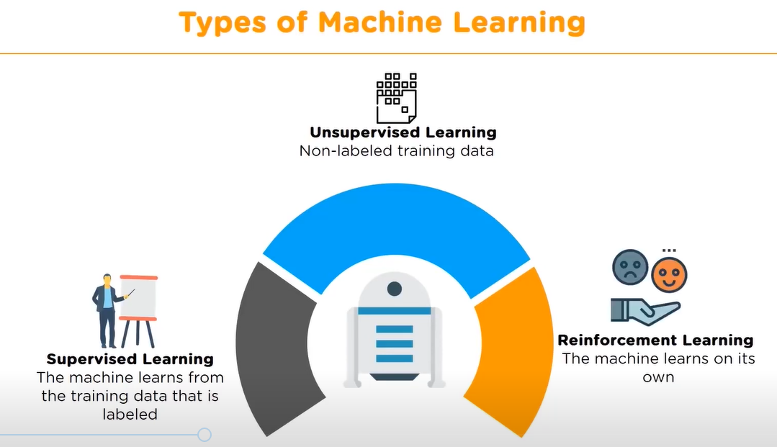
ABOUT THE DOMAIN
Machine Learning
Machine learning is a field of computer science, an application of artificial intelligence, which provides computer systems the ability to learn with data and improve from experience without being explicitly programmed.
The main focus of machine learning is to allow the computers learn automatically without human intervention.

Slide 6
INTRODUCTION TO PROJECT
ABSTRACT
The "Used Bikes Price Prediction in India" dataset from Kaggle consists of information on used bikes from various cities in India, including their brand, model, manufacturing year, kilometers driven, fuel type, and seller type. The objective of this dataset is to develop a machine learning model that can predict the price of a used bike based on these features. The dataset contains 13,272 observations and 7 features, with the target variable being the selling price of the bike.

Slide 7
OBJECTIVES
Develop a machine learning model that can accurately predict the selling price of a used bike based on its features.
Analyze the impact of various features, such as brand, model, manufacturing year, kilometers driven, fuel type, and seller type, on the selling price of used bikes.
Help buyers and sellers of used bikes in India make informed decisions by providing insights into the factors that affect the price of used bikes.
Provide a real-world dataset for researchers and data scientists to develop and test machine learning models for price prediction and feature analysis.
Improve the accuracy of price prediction for used bikes, which can help in reducing the information asymmetry between buyers and sellers, and promote fair pricing practices in the used bike market in India.

Slide 8
PROBLEM STATEMENT
Develop a machine learning model that can accurately predict the selling price of a used bike based on its features.
Analyze the impact of various features such as brand, model, manufacturing year, kilometers driven, fuel type, and seller type, on the selling price of used bikes.
Help buyers and sellers of used bikes in India make informed decisions by providing insights into the factors that affect the price of used bikes.
Improve the accuracy of price prediction for used bikes, which can help in reducing the information asymmetry between buyers and sellers and promote fair pricing practices in the used bike market in India.

Slide 9
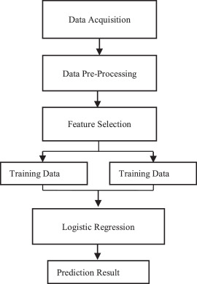
ARCHITECTURE

Slide 10
TASK ASSIGNED
Week no | Task assigned
Week 1 | Understanding Python Programming Language. Understanding and analysing of Artificial Intelligence Machine Learning Data Science Data Analytics. Big Data.
Week 2 | Understanding of Python. Working on programs in Python.
Week 3 | Understanding of Jupyter Notebook. Working on programs in Jupyter.
Week 4 | Research. Execution Result Analysis.

Slide 11
TASK PERFORMED
Week no | Task Completed
Week 1 | Introduction to Python Programming Language. Introduction to Data Science. Relation to Data Science. Algorithms of ML . Applications of ML. Techniques of ML. Introduction to Data Analytics. Types of Analytics. Evolution of Big Data.
Week 2 | Introduction to Python. Applications of Python. Few Programs Related to Python.
Week 3 | Introduction to Jupyter Notebook. Programs related to Jupyter Notebook. Introduction to Anaconda3.
Week 4 | Research. Purpose and Understanding. Process of Credit Card Fraud Detection Analysis. Data set variables. Execution and Analysis.

Slide 12
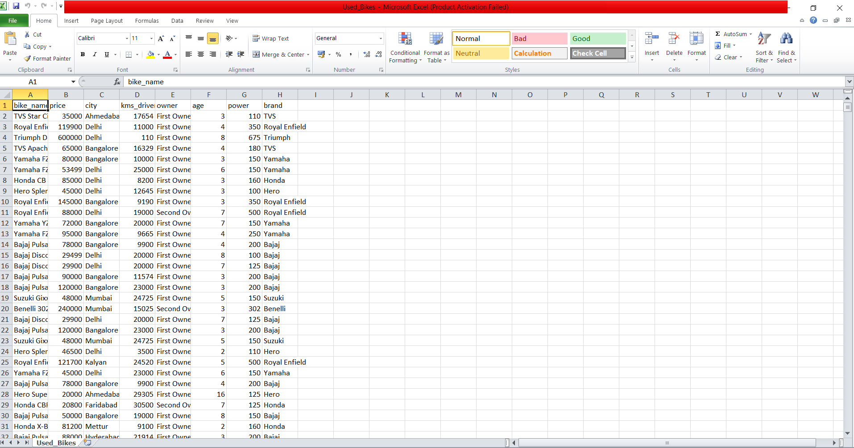
IMPLEMENTATION

Slide 13
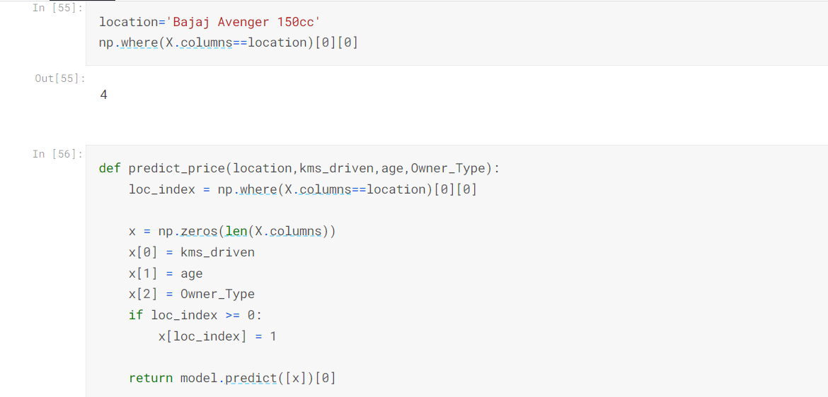
RESULT

Slide 14
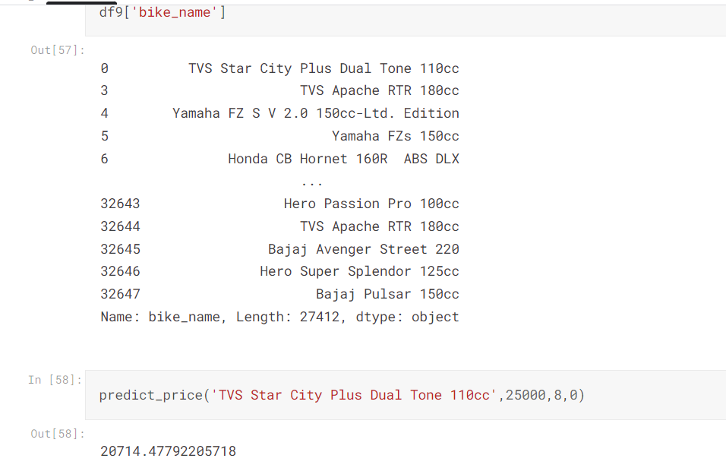

Slide 15
CONCLUSION
The dataset provides valuable information for developing machine learning models to predict the selling price of used bikes in India.
The dataset includes features such as brand, model, manufacturing year, kilometers driven, fuel type, and seller type, which can be used to analyze the factors affecting the selling price of used bikes.
Accurate price prediction models can help buyers and sellers make informed decisions and promote fair pricing practices in the used bike market in India.
The dataset has the potential to contribute significantly to the field of machine learning and pricing analysis in the used bike market in India.
Further research can be done to improve the accuracy of price prediction models and analyze additional factors affecting the selling price of used bikes in India.

Slide 16
APPLICATIONS
The dataset can be used by online used bike marketplaces to estimate the selling price of used bikes listed on their platform, which can help in setting fair pricing policies and reducing the information asymmetry between buyers and sellers.
Insurance companies can use the dataset to estimate the market value of used bikes and set premiums accordingly.
Buyers and sellers of used bikes can use the dataset to get an estimate of the fair price of a bike based on its features, which can help in negotiating better deals.
The insights from the dataset can be used by bike manufacturers and dealers to estimate the market value of used bikes and set competitive prices for their new models.
The dataset can be used by financial institutions to estimate the value of used bikes as collateral for loans.
The dataset can be used by government agencies to analyze the used bike market in India and identify trends and patterns that can help in policy-making and regulating the market.

Slide 17
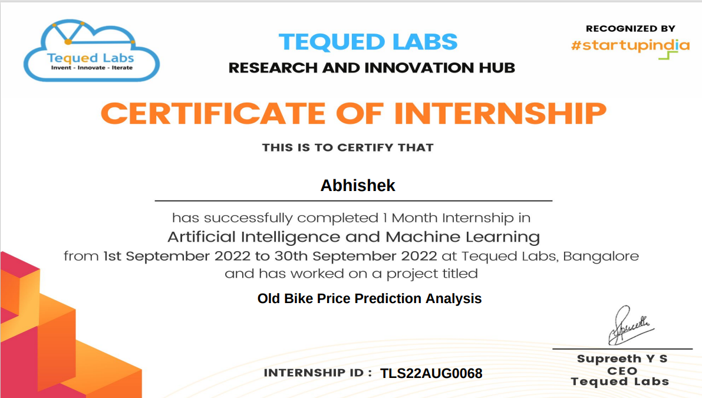
CERTIFICATE

Slide 18
THANK YOU

